Slide 1
February 2025 Battery FIAMM – Riyadh L3
ALSTOM RS
2025-02-10
Caio Oliveira

Slide 2
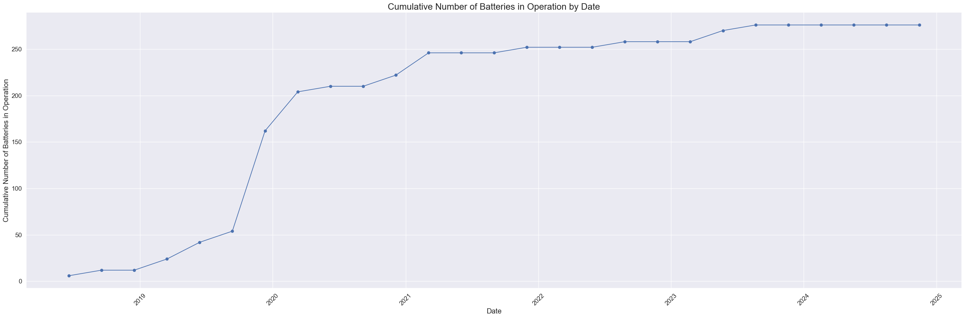
MTBF – Instantaneous
Total of 276 batteries in operation
Total time of 11,690,712 hours

Slide 3
MTBF – Previous Results #1
MTBF for the last 90 days (Aug to Oct/23) was 65,643 hours.
The demonstrated Cumulative MTBF (Up to Oct/23) for the fleet was 48,262 hours.

Slide 4
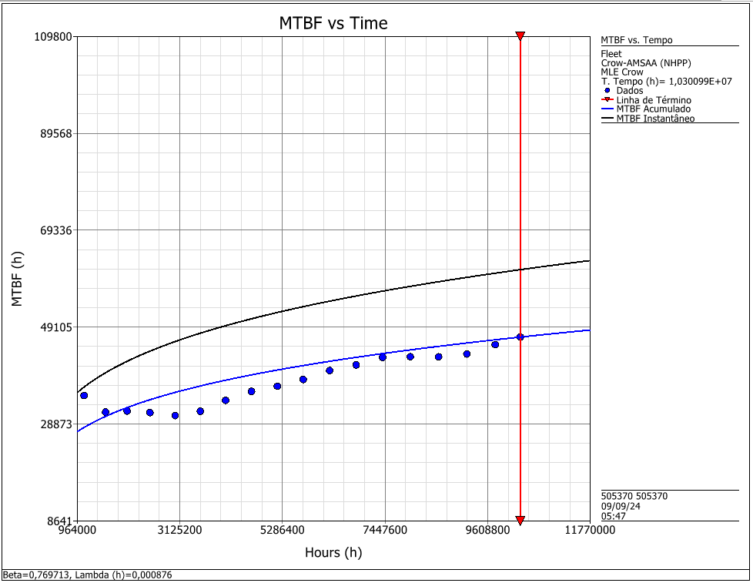
MTBF – Previous Results #2
MTBF for the last 90 days (May to Jul/24) is 61,109 hours.
The demonstrated Cumulative MTBF (Up to Jul/24) for the fleet is 47,036 hours.

Slide 5
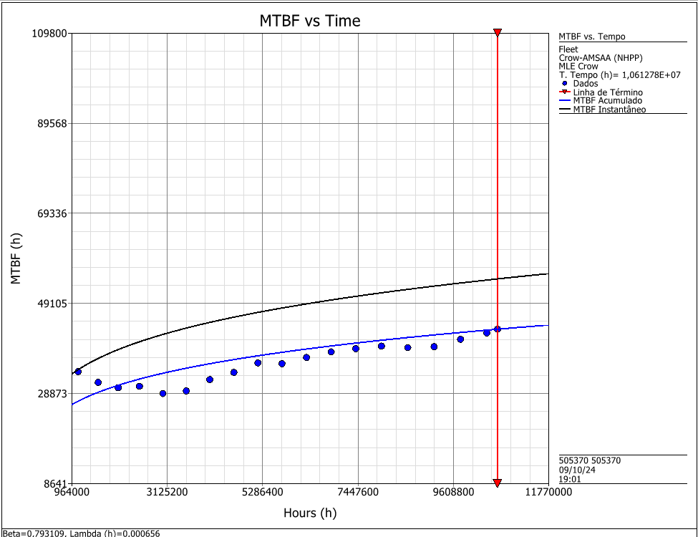
MTBF – Latest Result
MTBF for the last 90 days (Jul to Sep/24) is 54,617 hours.
The demonstrated Cumulative MTBF (Up to Sep/24) for the fleet is 43,317 hours.

Slide 6
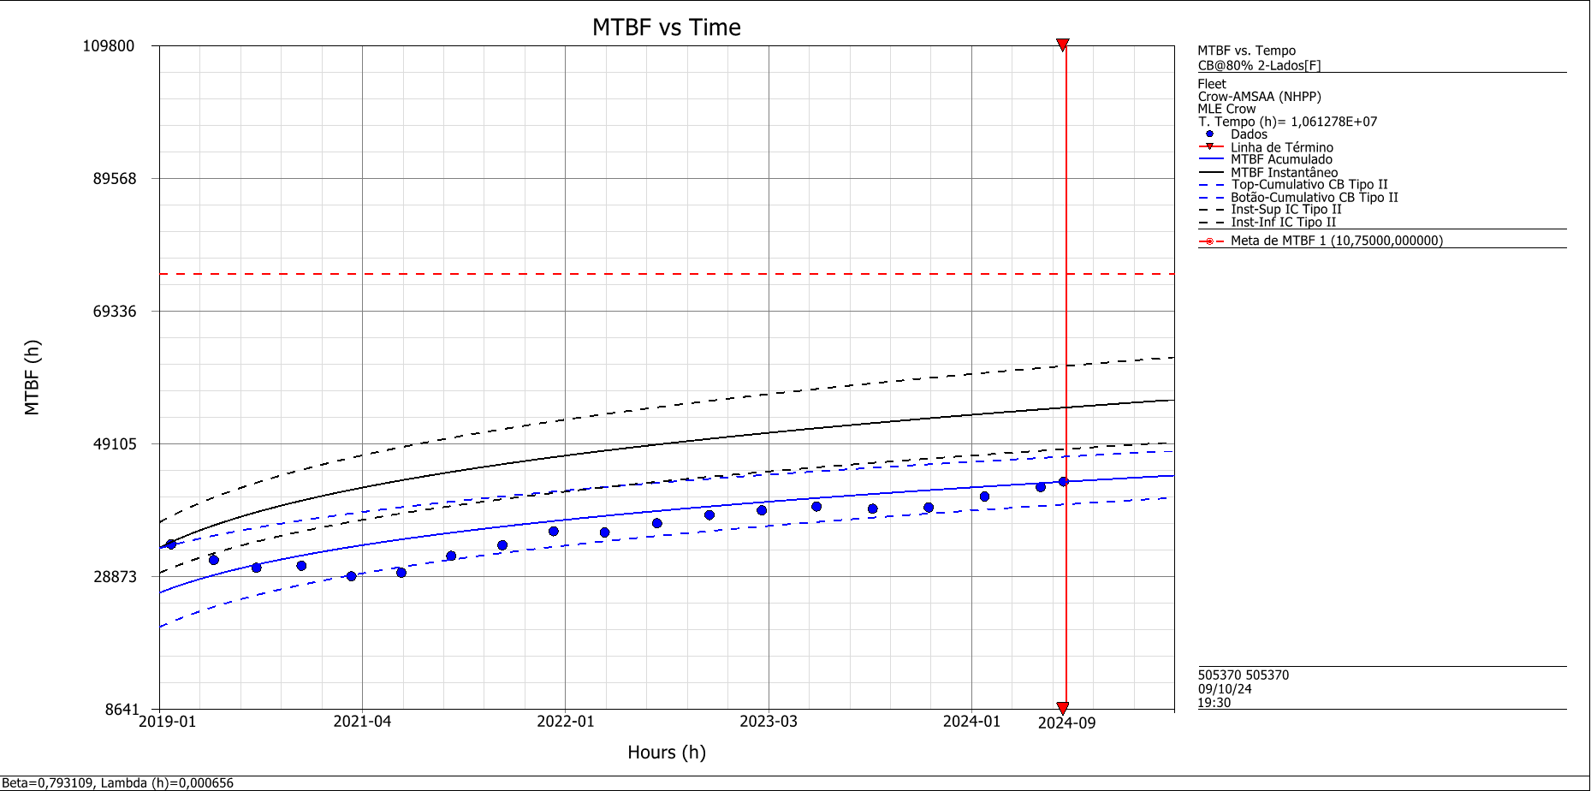
MTBF – Latest Result
MTBF for the last 90 days (May to Jul/24) is 54,617 hours.
The demonstrated Cumulative MTBF (Up to Jul/24) for the fleet is 43,317 hours.

Slide 7
MTBF – Previous Results
MTBF Urgent – 56,290 hours
Battery Controller Failure
Battery Main Contactor Failure
Charge Regulator Failure
Communication Error
Heating System Fault
High Battery Voltage
Low Battery Voltage
String Voltage Unbalance
Temperature Probe Error
MTBF Non-Urgent - 286,139 hours
Fault Clear itself
String Voltage Unbalance
New failure database – 41 Events
Need Same Day Action | 25
Battery Controller Failure | 2
Battery Main Contactor Failure | 1
Communication Error | 3
High Battery Voltage | 1
Low Battery Voltage | 2
String Voltage Unbalance Alarm | 16
No Immediate Action | 16
String Voltage Unbalance Warning | 16

Slide 8
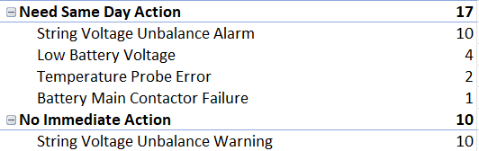
MTBF – Latest Result
MTBF Urgent – 209 Failures – 50,778 hours
String Voltage Unbalance
Charge Regulator Failure
Low Battery Voltage
Fault Clear itself
Battery Controller Failure
Heating System Fault
High Battery Voltage
Communication Error
Temperature Probe Error
Battery Main Contactor Failure
MTBF Non-Urgent - 36 Failures - 294,800 hours
String Voltage Unbalance
New failure database – 27 Events

